Slide 1
EE 596 – Image and Video Coding
Mini Project
Design of an Hybrid Codec for Image and Video Coding
Project Presentation
Peiris R.C.P.D
E / 13 / 251

Slide 2
Introduction
Hybrid video coding is an advanced coding technique which contains both predictive coding and transform coding.
In this work, a simple hybrid image & video codec is implemented using C++ and openCV, with coding tools DCT, iDCT, quantization, motion estimation/compensation & entropy coding. The performance of the codec is optimizing by adjusting those tools’ parameters.
Eventually, the codec is developed in such a way that it responsive to the transmission conditions such as channel bandwidth/bit-rate changes, support error resilience and concealments [These parts are developed in minor level and developments are in progress].
And the quality is measured by Objective and Subjective metrics.

Slide 3
Block Diagram of the Codec Design
Code Controller
+
Buffer
[Motion Data, Transform Coefficients]
Video Input
Image Encoder
-
CHANN
E
L
Motion Compensation
Image Decoder
Image Encoder/Decoder
Entropy Encoder
Video Decoder
Motion Estimation
Previous Frame
Control Data

Slide 4
Image Encoder/Decoder
Input Image
DCT Transform
Quantization
Huffman Encoding
Code Controller
Channel
Decoded Image
iDCT Transform
Huffman Decoding
Dequantization

Slide 5
In each image it take blocks (8x8,12x12,16x16) and transform it using DCT . After the whole image transformed it is quantized by 2^n factor. Then whole image is entropy encoded using Huffman Coding. This process is done by plane by plane (RGB) and finally merge.
As observed the quality is determined by quantization and size determined by block size.

Slide 6

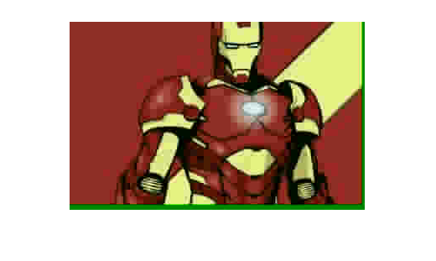
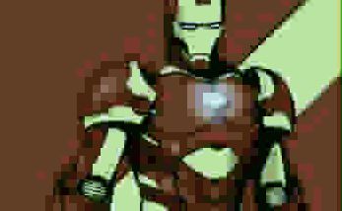
Results of Image Coding
Original Photo
Size: 2,491 KB
Picture 1
Q.Level 8
C.Level 1
Size : 562KB
CT : 4.44
Picutre 2
Q.Level 8
C.Level 2
Size : 559 KB
CT : 4.45
Picture 3
Q.Level 2
C.Level 3
Size : 174 KB
CT : 14.31

Slide 7
Results of Image Coding Cont.
Combination | File Size (KB) / CT | MSE | PSNR | Subjective Score
Q2 C1 | 255 / 9.76 | 39.0049 | 63.57 | 2
Q2 C2 | 238 / 10.46 | 42.640 | 62.67 | 2
Q2 C3 | 174 / 14.31 | 55.826 | 59.99 | 1
Q4 C1 | 355 / 7.01 | 7.8052 | 79.66 | 3
Q4 C2 | 345 / 7.22 | 10.8264 | 76.39 | 3
Q4 C3 | 290 / 8.58 | 12.2764 | 75.13 | 2
Q8 C1 | 562 / 4.44 | 0.3354 | 111.34 | 9
Q8 C2 | 559 / 4.45 | 0.4097 | 109.13 | 9
Q8 C3 | 538 / 4.68 | 0.2777 | 113.036 | 8
Combination : Q2C1 is Quality 2 Compression Level 1 || Subjective Score : 0 – Bad Quality , 10 – Best Quality
Original File Size : 5,491 KB

Slide 8
Video Encoder/Decoder
The Video Coding is done with general tools that we learned, using Inter Prediction, Block Matching and Motion Prediction.
In this work a Group of Picture (GOP) is a I PPP PPP PPP . The full search method is used for the motion estimation.
After the motion compensation of a particular P frame, the residual is taken to transmit. The estimation motion vectors are also transmitted. Both are entropy encoded, the residual is lossy and the motion vectors are coded lossless.
In the buffer is priorities the motion vectors to send carefully, the residual is the next priority. As a data partitioning technique the residual and motion vectors are kept in separate arrays to send.

Slide 9
Developments
For the Video Encoder / Decoder, it is target the transmission in a lossy medium uninteruptly. In this development it is enable live transmitting the video. If any interrupt happen in the channel, the feedback to the code control will adjust the bit-rate and transmit continuously for given quality.
When transmitting the pre encoded video, it can be keep and load several videos with several quality and bitrates. When transmitting if interrupt occurs the code control switched the steam to appropriate level keeping the bit rate.

Slide 10
Thank You…!

